Slide 1


Consumer Good
Atliq Hardware
AD-HOC Analysis
SQL Project Challenge
Inbatamilan Balasubramanian
Function : Executive Management

Slide 2
Problem Statement:
The management of Atliq, a top hardware manufacturer in our nation, wants to grow its data analytics team so that it may have access to enough information to make swift and informed choices.
Approach:
To respond to the ad-hoc request, query the data using SQL.
Use Powerbi and excel to create the visualisations, and then provide the management with key findings insights.

Slide 3
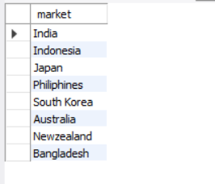
Request 1 : Provide the list of markets in which customer "Atliq Exclusive" operates its business in the APAC region.
The countries where the Atliq Exclusive operates in the APAC region include India, Indonesia, Japan, the Philippines, South Korea, Australia, New Zealand, and Bangladesh.

Slide 4
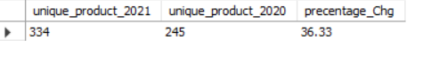
Request 2 : What is the percentage of unique product increase in 2021 vs. 2020?

Slide 5
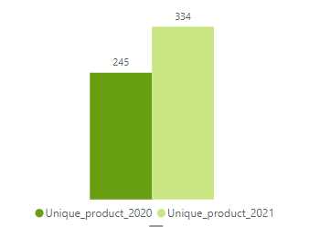
Insights
The unique product that increases in 2021 are 36.33% that means 89 new products were added.

Slide 6
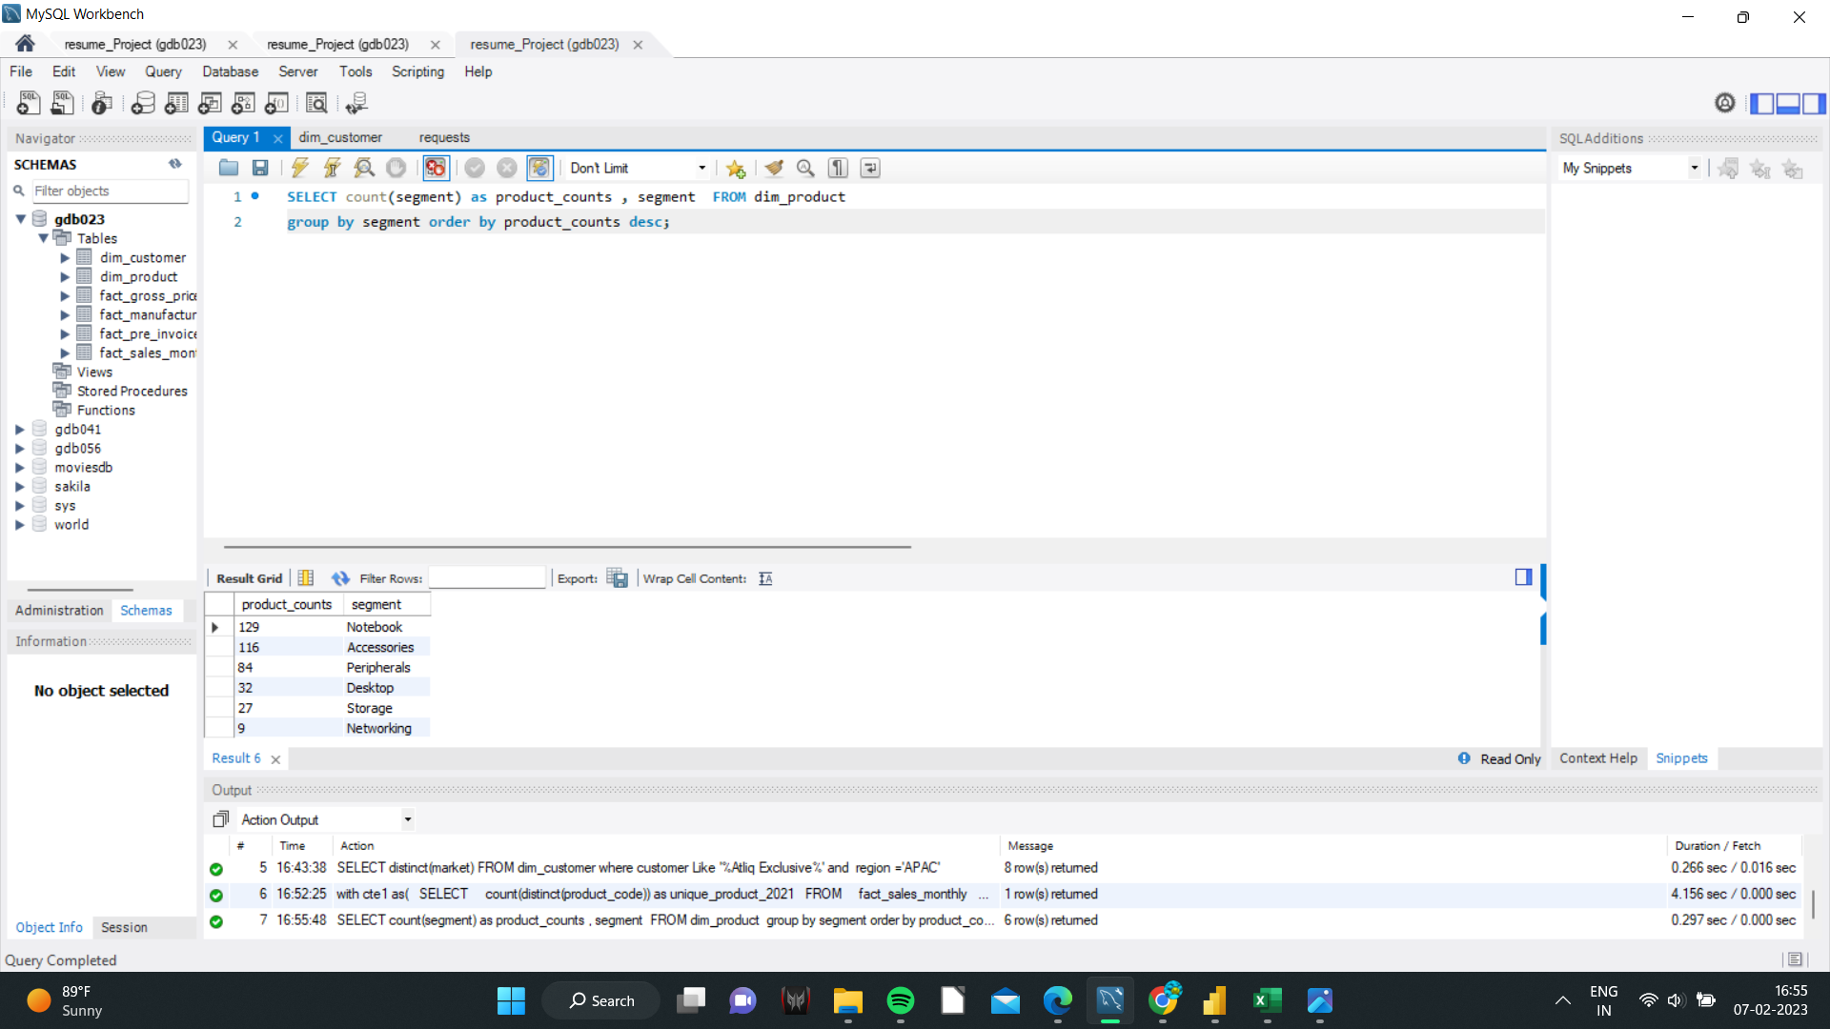
Request 3 : Provide a report with all the unique product counts for each segment and sort them in descending order of product counts.

Slide 7
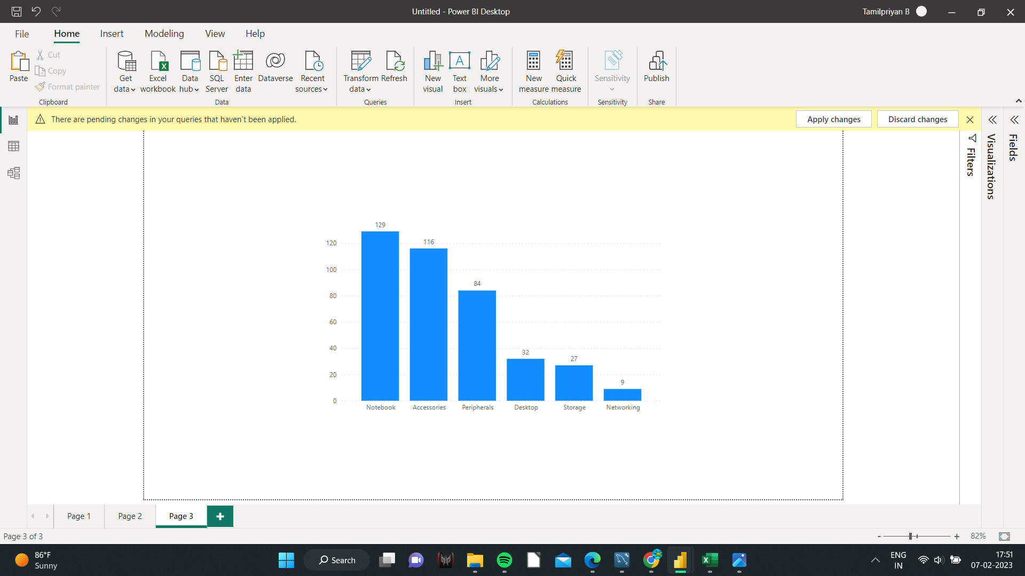
Insights
The segments we have in the atliq hardware are notebook,accessories,peripheral,desktop,storage,networking. In that the top 3 segments are
Notebook
Accessories
Peripheral

Slide 8
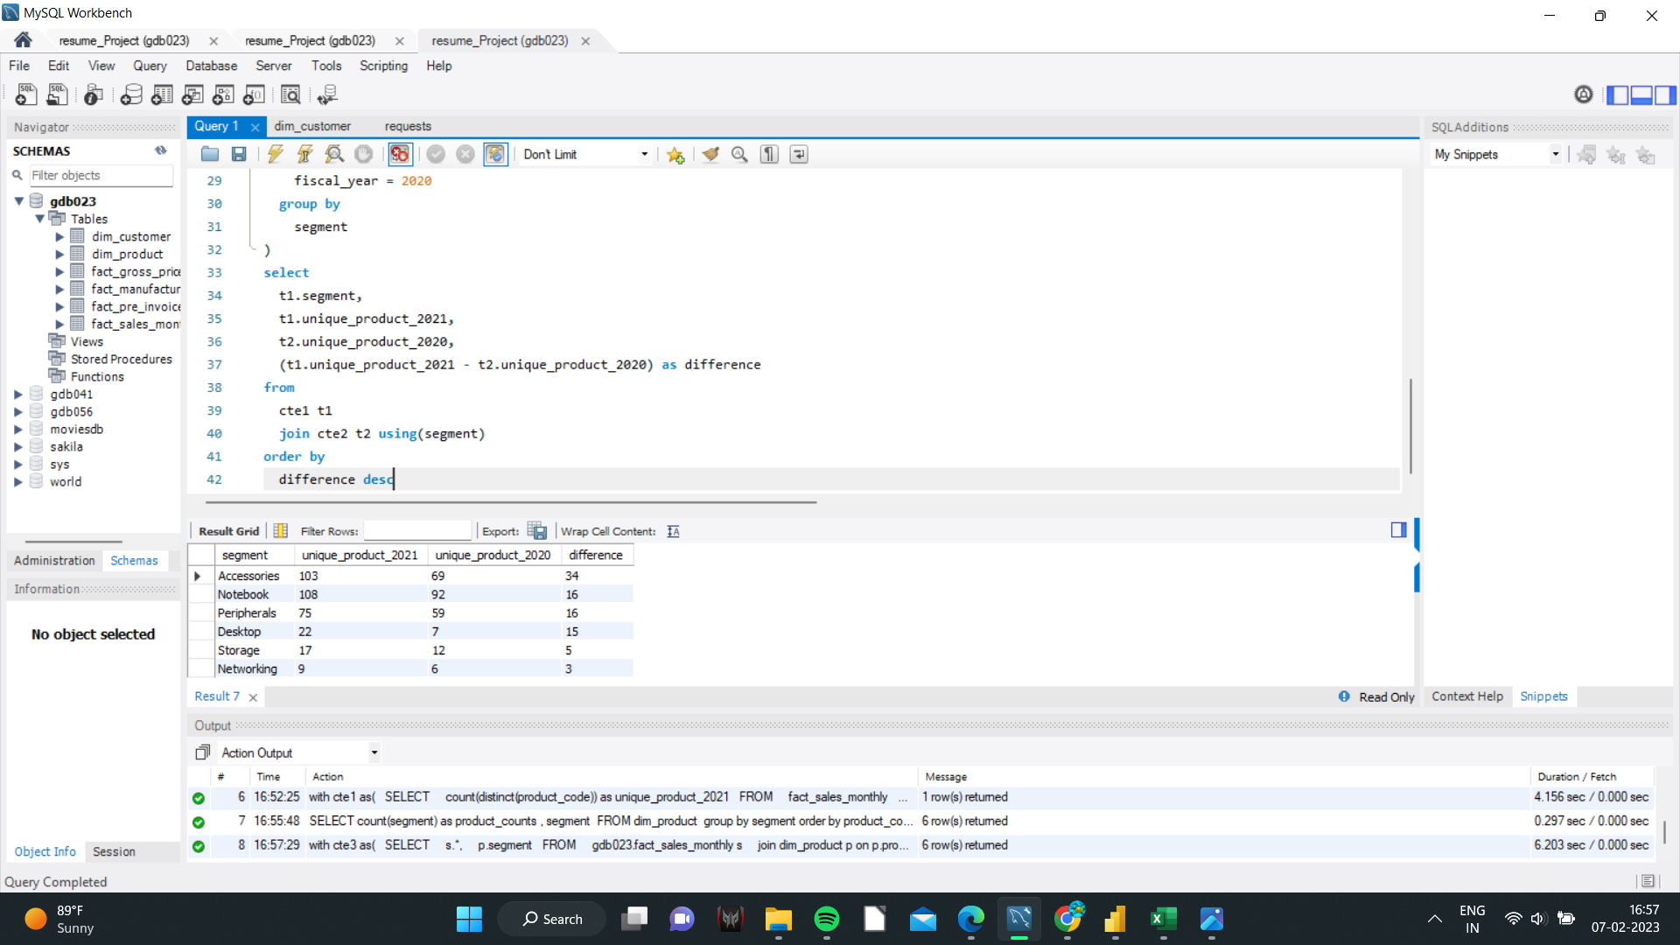
Request 4 : Which segment had the most increase in unique products in 2021 vs 2020?

Slide 9
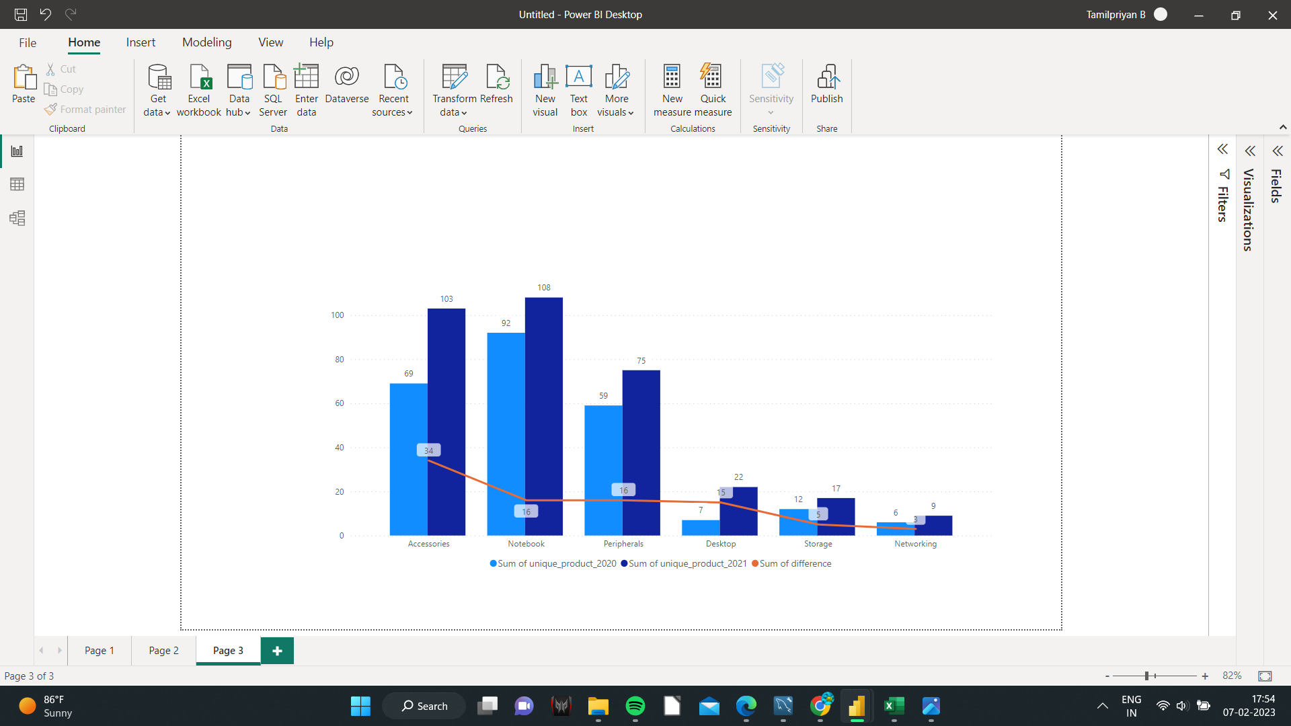
Insights
By analysing Request 2, we already knew that 89 new products were added to the Atliq hardware line in 2021, with Accessories having the highest unique product growth and Networking having the least.

Slide 10
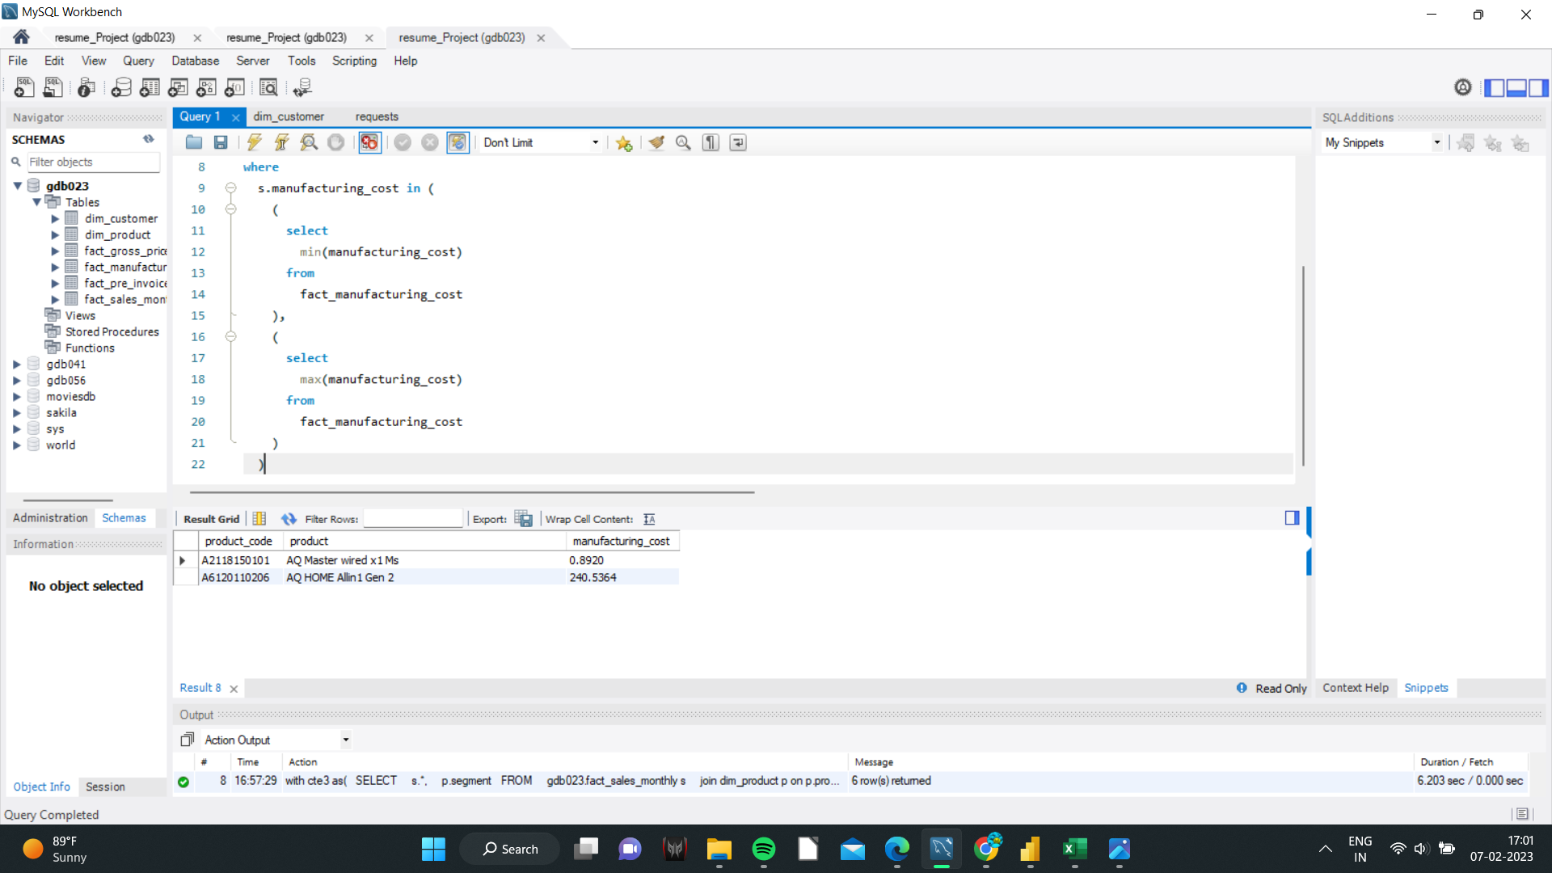
Request 5 : Get the products that have the highest and lowest manufacturing costs.

Slide 11
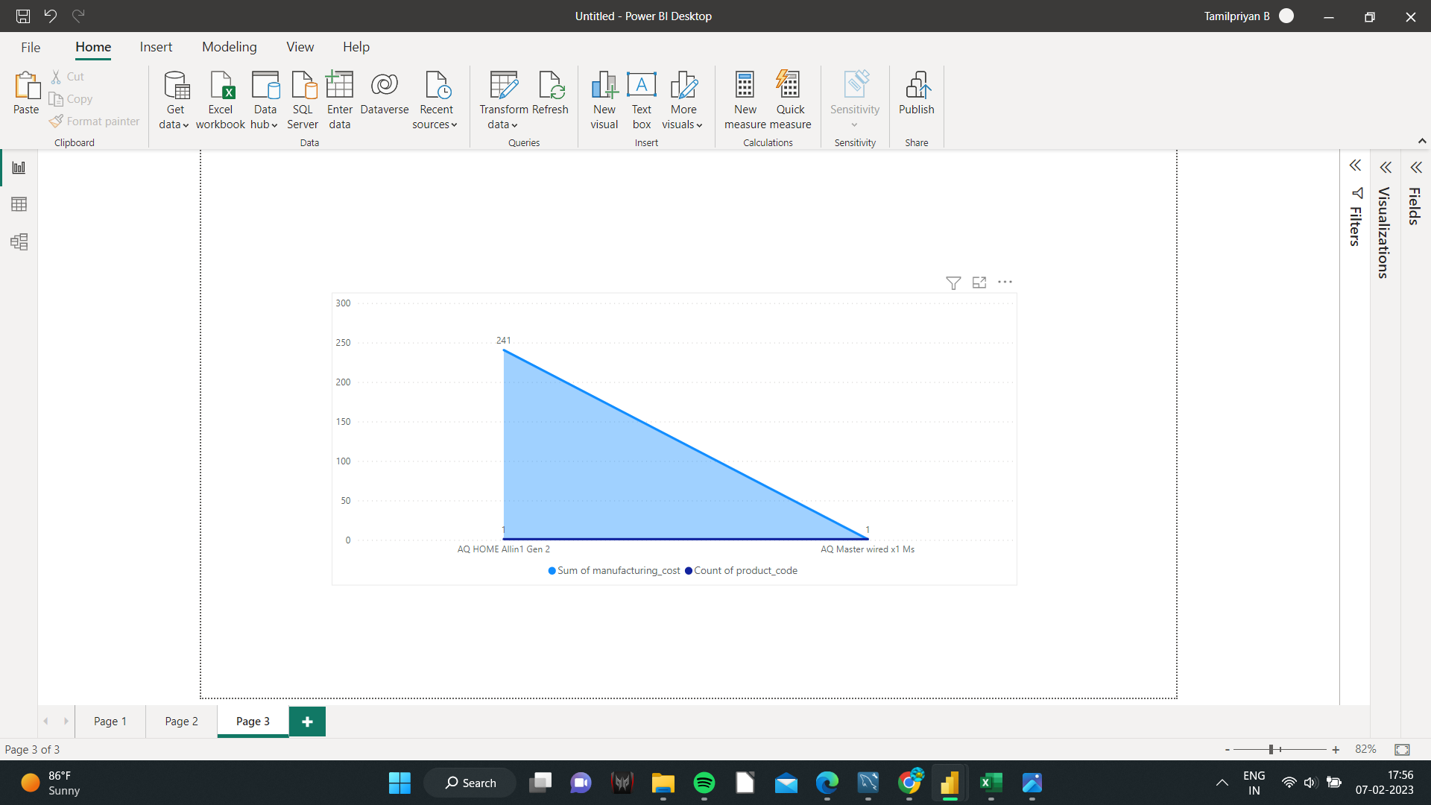
Insights
In that visualisation, it was evident that AQ HOME Allin1 Gen2 had the highest production costs while AQ Master wiredx1 Ms had the lowest.

Slide 12
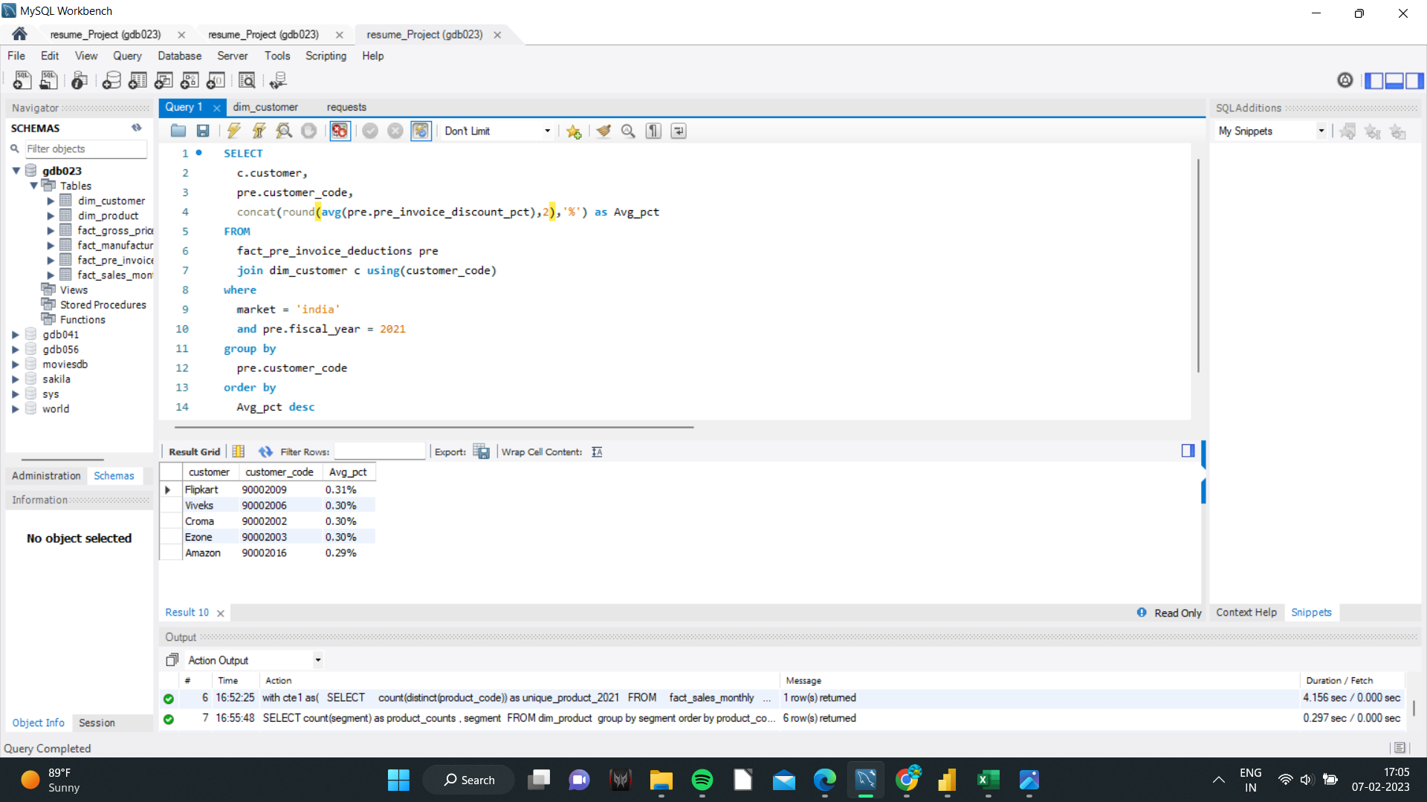
Request 6 : Generate a report which contains the top 5 customers who received an average high pre_invoice_discount_pct for the fiscal year 2021 and in the Indian market.

Slide 13
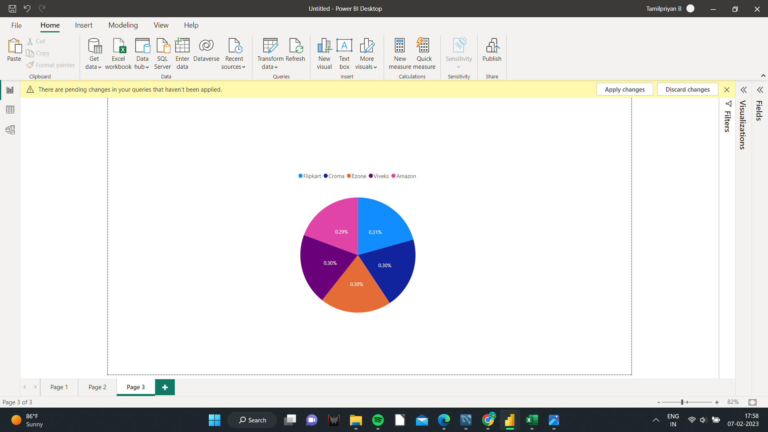
Insights
Flipkart, Viveks, Croma, Ezone, and Amazon are the top 5 clients that, on average, earned a significant pre-invoice discount percentage for the fiscal year 2021 in the Indian market.

Slide 14
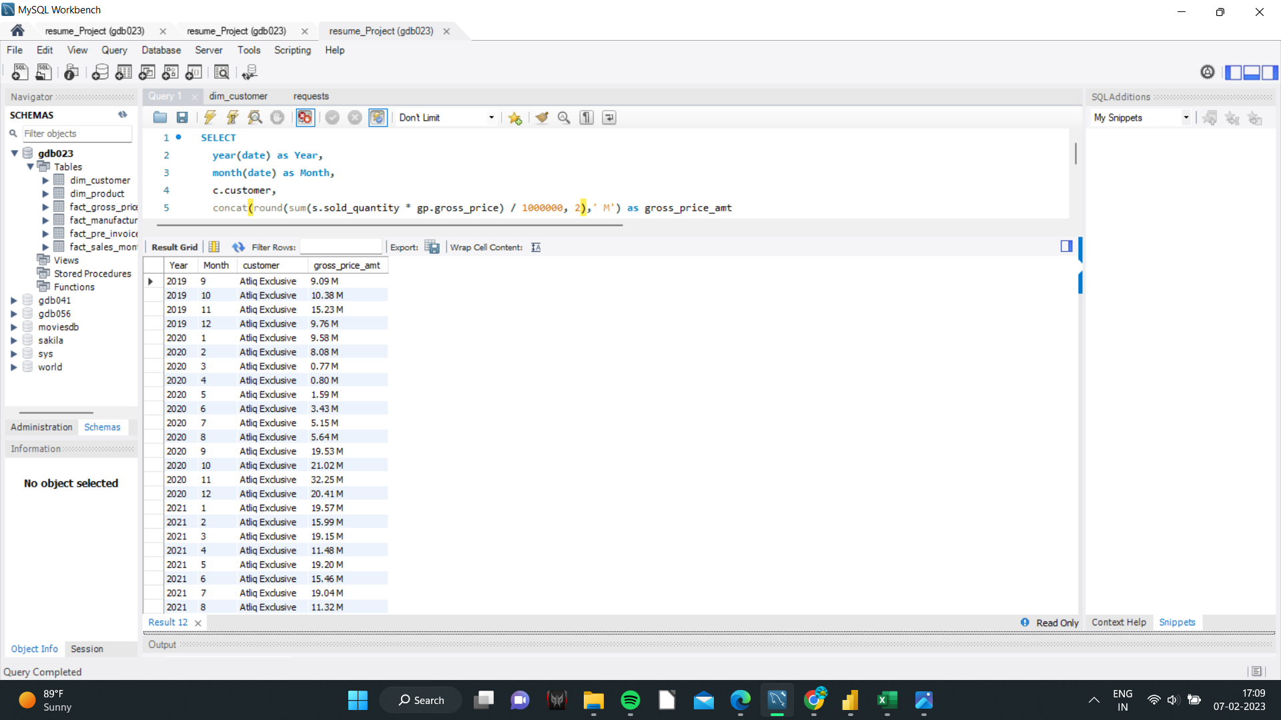
Request 7 : Get the complete report of the Gross sales amount for the customer “Atliq Exclusive” for each month. This analysis helps to get an idea of low and high-performing months and take strategic decisions.

Slide 15
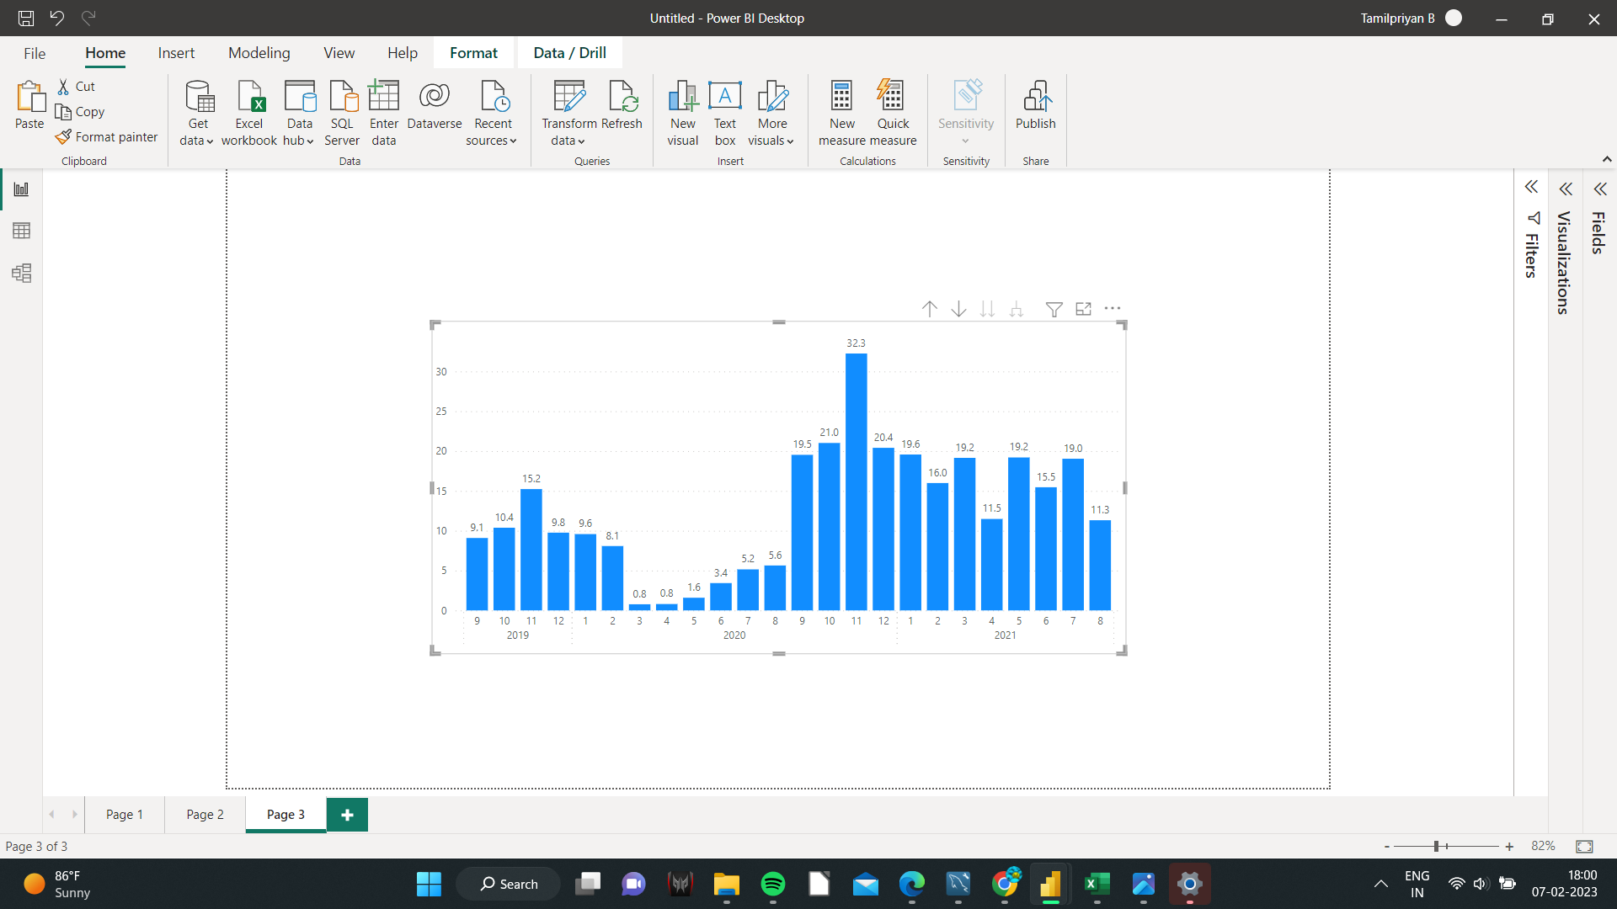
Insights
March and April in 2020 were the least productive months.
November 2020 had the best overall performance.

Slide 16
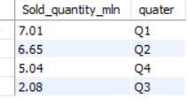
Request 8 : In which quarter of 2020, got the maximum total_sold_quantity? The final output contains these fields sorted by the total_sold_quantity

Slide 17
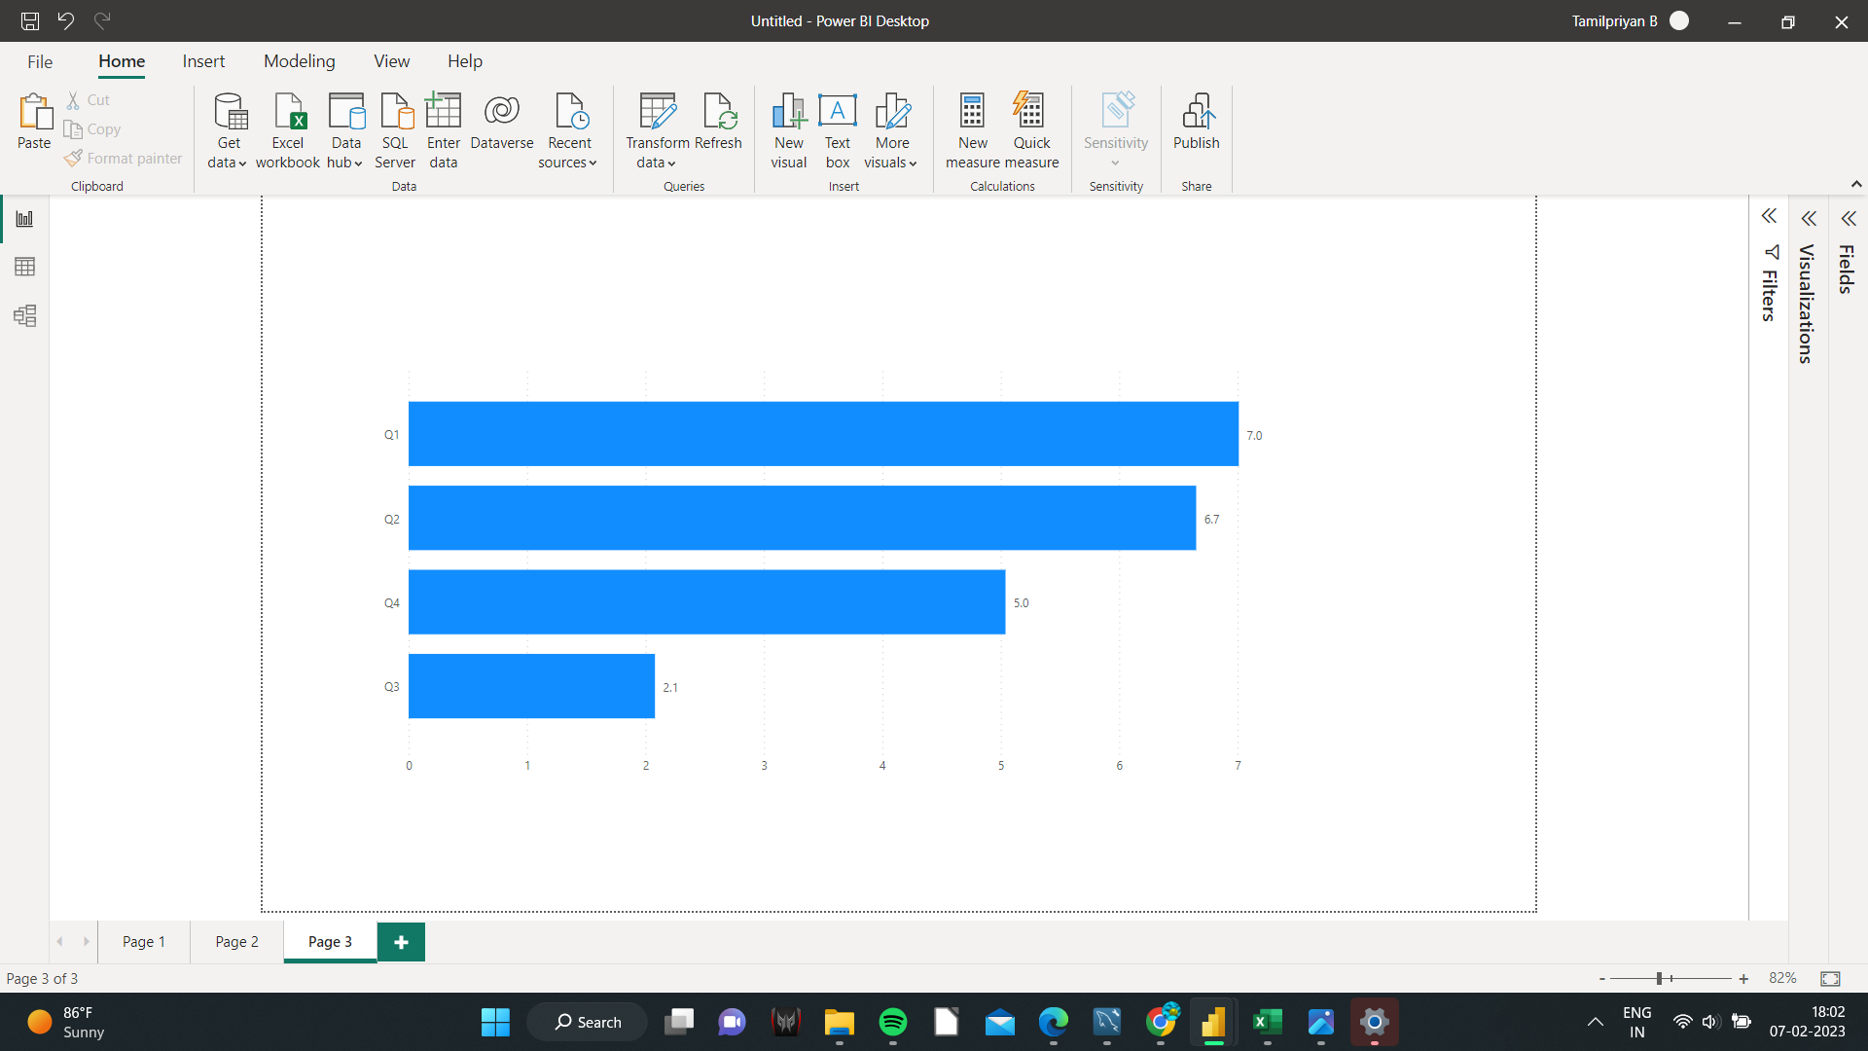
Insights
The highest total sold quantity was recorded in Quarter One (Sep, Oct, Nov) of 2020, while the lowest total sold quantity was recorded in Quarter Three.

Slide 18
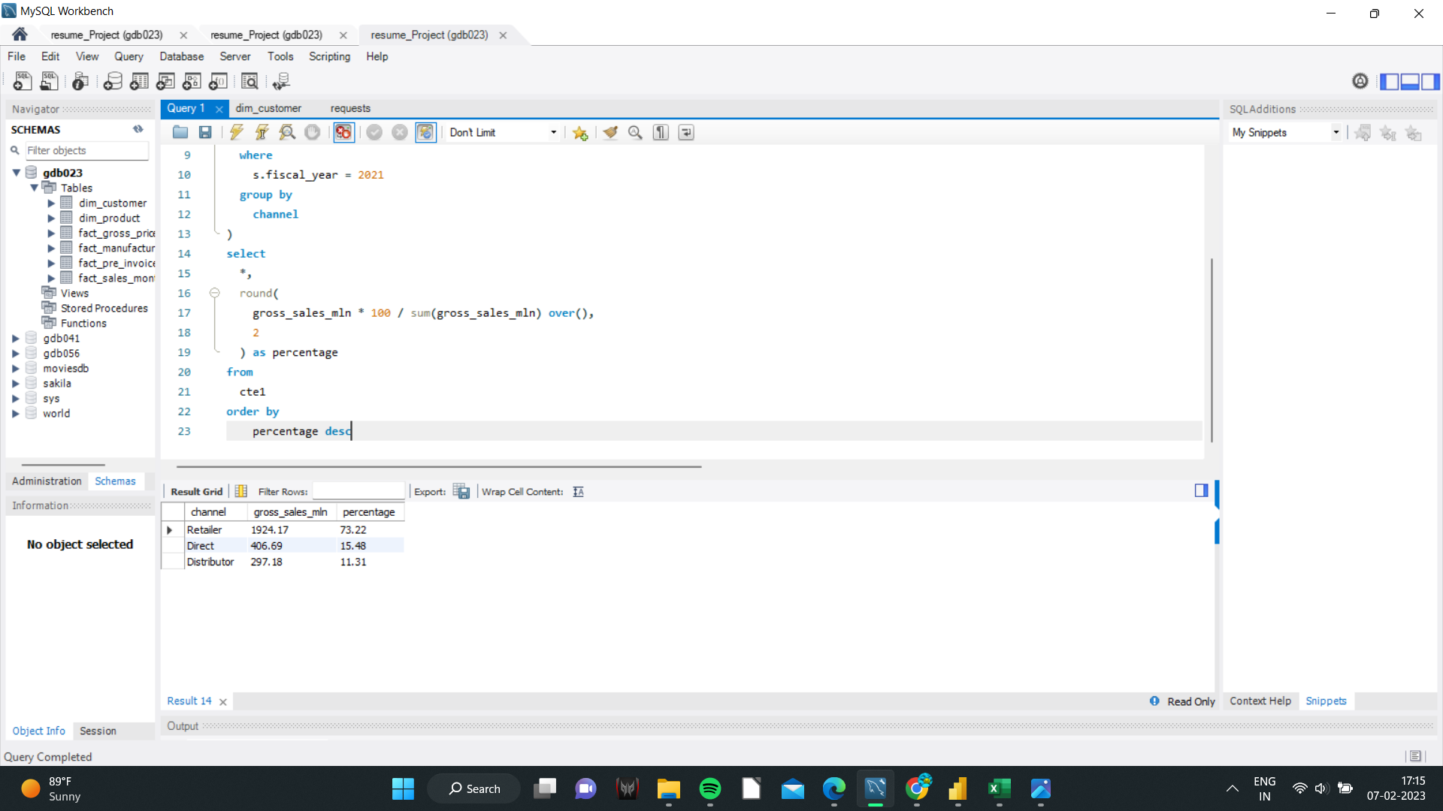
Request 9 : Which channel helped to bring more gross sales in the fiscal year 2021 and the percentage of contribution?

Slide 19
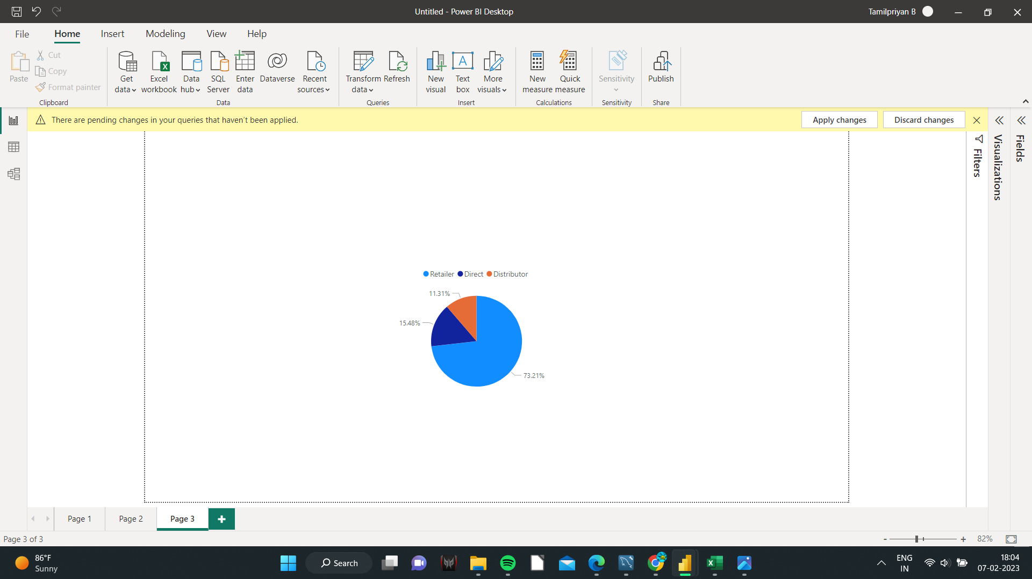
Insights
The retail channel contributed 73.21% of the total increase in gross sales for the fiscal year 2021.

Slide 20
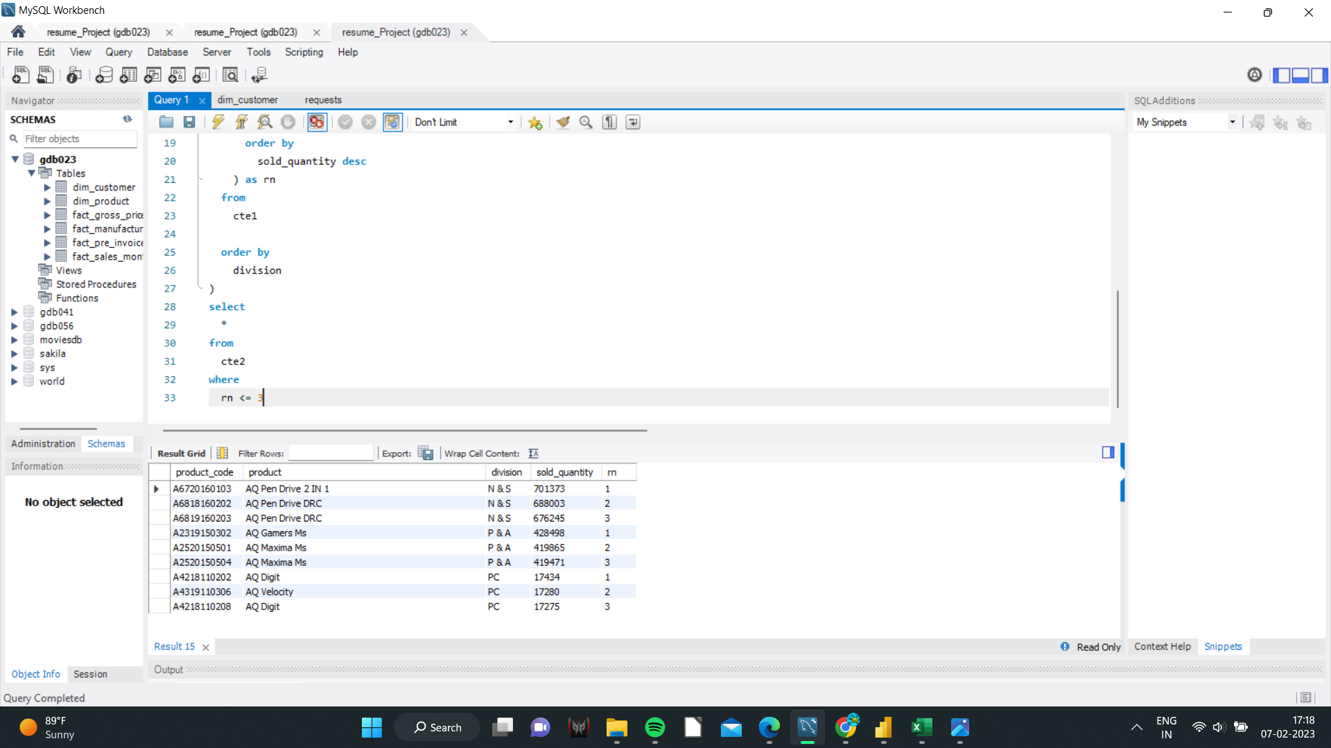
Request 10 : Get the Top 3 products in each division that have a high total_sold_quantity in the fiscal_year 2021?

Slide 21
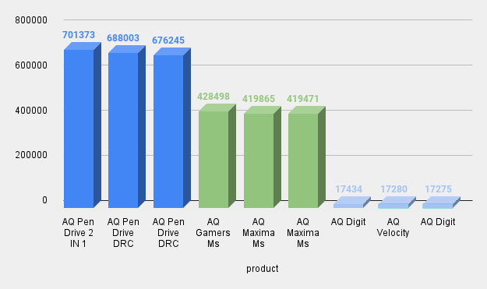
Insights
In the fiscal year 2021, the top three items in each division with the highest total sales quantity are:
1) N&S - [AQ Pen Driver 2 IN 1, AQ Pen Driver DTC]
2) P&A — [AQ Maxima MS, AQ Gamers MS]
3) Computer: [AQ Digit, AQ Velocity, AQ Digit]

Slide 22
I appreciate you taking the time to review my work, and your comments are appreciated.
THANK YOU :)

